Slide 1
Characteristics of Planar Graphs
By: George Ge
Mentor: Zachary Greenberg

Slide 2
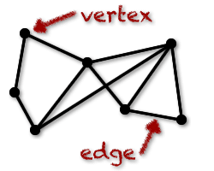
What is a graph?
Vertices
Edges
Variations
Weighted
Colored (Labeled)
Directed
http://world.mathigon.org/resources/Graph_Theory/graph.png

Slide 3
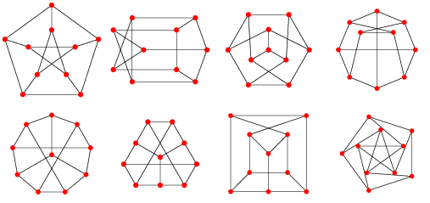
What is an embedding?
Peterson Graph
http://www.imada.sdu.dk/~btoft/GT2009/PetersenGraphEmbeddings_800.gif

Slide 4
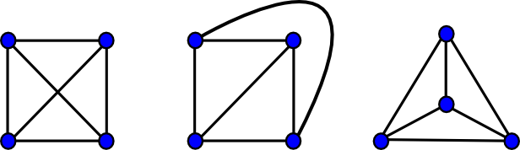
What is a planar embedding?
K₄
http://www.boost.org/doc/libs/1_49_0/libs/graph/doc/figs/planar_plane_straight_line.png

Slide 5
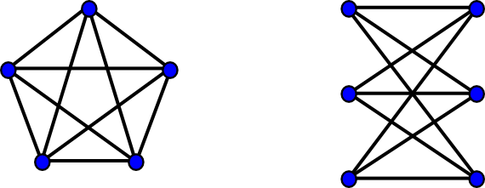
Kuratowski Subgraphs
K₅
K_{3,3}
http://www.boost.org/doc/libs/1_49_0/libs/graph/doc/figs/k_5_and_k_3_3.png

Slide 6
Nonplanarity of K₅ and K_{3,3}
CAN’T ADD RED WITHOUT CROSSING
CAN’T ADD RED OR GRAY WITHOUT CROSSING

Slide 7
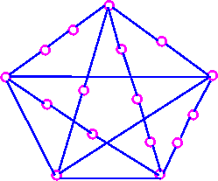
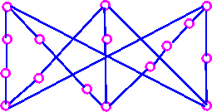
What is a subdivision?
Kuratowski Subgraphs
http://www.personal.kent.edu/~rmuhamma/GraphTheory/MyGraphTheory/Diagrams/g83.gif
http://www.personal.kent.edu/~rmuhamma/GraphTheory/MyGraphTheory/Diagrams/g82.gif

Slide 8
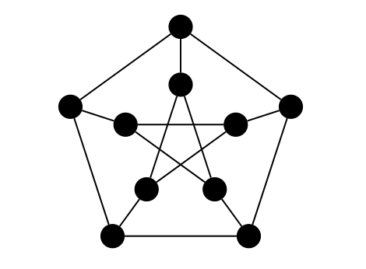
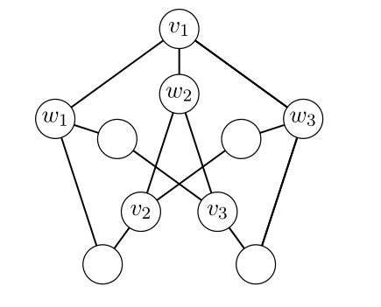
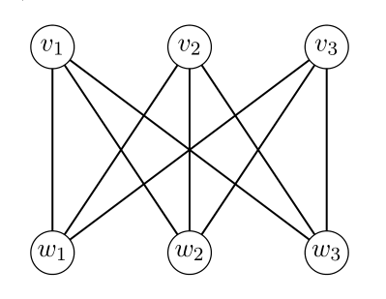
Kuratowski’s Theorem (1930)
A graph is planar if and only if it does not contain a subdivision of K₅ or K_{3,3}.
http://www.math.ucla.edu/~mwilliams/pdf/petersen.pdf

Slide 9
Minimal Nonplanar
Nonplanar graph that becomes planar upon removal of any vertex or edge.
If we prove that every minimal nonplanar graph must contain a Kuratowski subgraph then we have proved that every nonplanar graph must contain a Kuratowski subgraph as all nonplanar graphs must contain a minimal nonplanar subgraph.

Slide 10
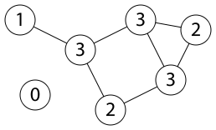
Connected Graphs
https://en.wikipedia.org/wiki/Connectivity_%28graph_theory%29#/media/File:UndirectedDegrees.svg

Slide 11
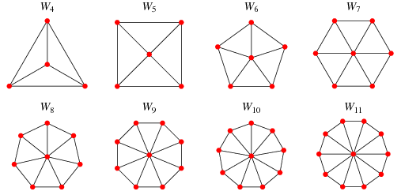
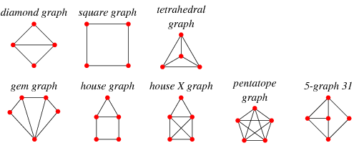
K-Connectivity
2-connected (biconnected)
3-connected wheel graphs
http://mathworld.wolfram.com/BiconnectedGraph.html
http://mathworld.wolfram.com/WheelGraph.html

Slide 12
Proof Outline
Assume there exists a minimal nonplanar graph without a Kuratowski subgraph.
Every minimal nonplanar graph without Kuratowski subgraphs must be 3-connected.
Every graph that is 3-connected without Kuratowski subgraphs has a planar embedding.
Thus every minimal nonplanar graph without a Kuratowski subgraph must have a planar embedding.
CONTRADICTION!

Slide 13
Every minimal nonplanar graph is connected.
NonPlanar graph with 2 components
Smaller nonplanar graph
Other
Vertices\Edges
NON
PLANAR
Component
NON
PLANAR
Contradicts our Assumption of Minimal Nonplanar

Slide 14
Every minimal nonplanar graph is 2-connected.
ASSUME THERE IS A CUT-VERTEX
Planar Embedding
Nonplanar with cut vertex
PLANAR
4
PLANAR
4
PLANAR
Contradicts our Assumption of Minimal Nonplanar

Slide 15
The End.

